Slide 1
Geometry
Agenda
1. ENTRANCE
2. Go over Practice
3. 6-6 Coordinate Geometry
4. Practice Assignment
5. EXIT

Slide 2
Practice WB 6-5 # 1-6, 8, 10-15, 17

Slide 3
Chapter 6
6-6 Coordinate Geometry

Slide 4
Quadrilateral Property Summary
Kites
1.
2.
3.
4.
5.

Slide 5
Quadrilateral Property Summary
Trapezoids
1.
Isosceles Trapezoids (in addition to trapezoid properties)
1.
2.
3.

Slide 6
Quadrilateral Property Summary
Parallelograms
1.
2.
3.
4.
5.
6.

Slide 7
Quadrilateral Property Summary
Rectangles (in addition to properties of a parallelogram)
1.
2.
Rhombus (in addition to properties of a parallelogram)
1.
2.
3.

Slide 8
Quadrilateral Property Summary
Squares have all properties of
____________________
____________________
____________________

Slide 9
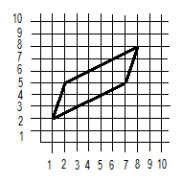
This figure appears to be a _________________. Property to show:________________________

Slide 10
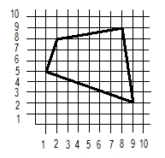
This figure appears to be a _________________. Property to show:________________________

Slide 11
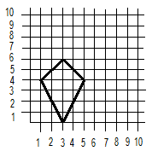
This figure appears to be a _________________. Property to show:________________________

Slide 12
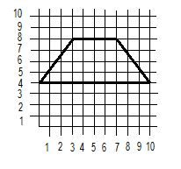
This figure appears to be a _________________. Property to show:________________________

Slide 13
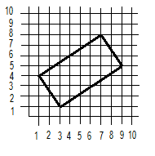
This figure appears to be a _________________. Property to show:________________________

Slide 14
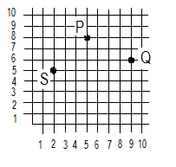
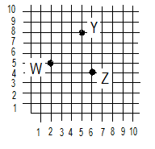
Place a point so that the figure is a parallelogram.
R in figure PQRS X in figure WXYZ

Slide 15
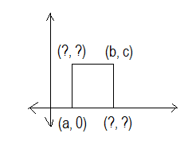
Use the properties of each figure to find the missing coordinates.
square

Slide 16
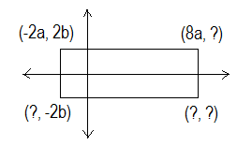
Use the properties of each figure to find the missing coordinates.
rectangle

Slide 17
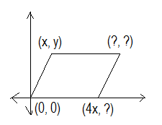
Use the properties of each figure to find the missing coordinates.
parallelogram

Slide 18
Practice
Handout
WB 6-6 # 13-18
EXIT

